Slide 1

COMS W4111 - Introduction to Databases
DBMS Architecture and Implementation: Transactions (Cont.), Recovery, NoSQL Databases
Donald F. Ferguson (dff@cs.columbia.edu)
Lecture 12: Transactions, Recovery, No SQL

Slide 2

Contents
2 | Introduction to Databases (F18): Lecture 12 -- Transactions, NoSQL

Slide 3
Contents
Completing transactions and recovery:
I made a few mistakes (around isolation) when using the chalkboard to “clarify” slides.
Examples in this space can be tricky and detailed, and ”winging it” often results in my making mistakes.
Specific topics:
Schedules and serializability.
Locking, deadlocks.
Optimistic transactions.
ETags.
NoSQL Databases:
Concepts, classification, motivation.
CAP Theorem
Eventual Consistency
Three examples: Redis, Neo4J, DynamoDB
Usage scenarios for each.

Slide 4
Transactions/Recovery: Correction and Continued
4 | Introduction to Databases (F18): Lecture 12 -- Transactions, NoSQL

Slide 5

Isolation Concept
5 | Introduction to Databases (F18): Lecture 12 -- Transactions, NoSQL

Slide 6
Serializability
“In concurrency control of databases,^{[1][2]} transaction processing (transaction management), and various transactional applications (e.g., transactional memory^{[3]} and software transactional memory), both centralized and distributed, a transaction schedule is serializable if its outcome (e.g., the resulting database state) is equal to the outcome of its transactions executed serially, i.e. without overlapping in time. Transactions are normally executed concurrently (they overlap), since this is the most efficient way. Serializability is the major correctness criterion for concurrent transactions' executions. It is considered the highest level of isolation between transactions, and plays an essential role in concurrency control. As such it is supported in all general purpose database systems.” (https://en.wikipedia.org/wiki/Serializability)

Slide 7
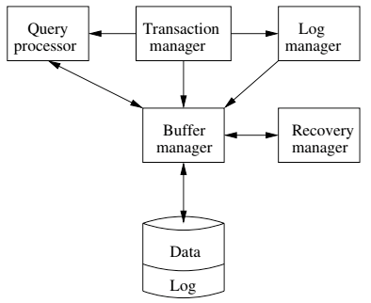
DBMS ACID Implementation
Implementation Subsystems
Query processor schedules and executes queries.
Buffer manager controls reading/writing blocks/frames to/from disk.
Log manager journals/records events to disk (log), e.g.
Transaction start/commit/abort
Transaction update of a block and previous value of data.
Transaction manager coordinates query scheduling, buffer read/write and logging to ensure ACID.
Recovery manager processes log to ensure ACID even after transaction or system failures.
Log is a special type of block file used by the system to optimize performance and ensure ACID.
Garcia-Molina et al., p. 846

Slide 8
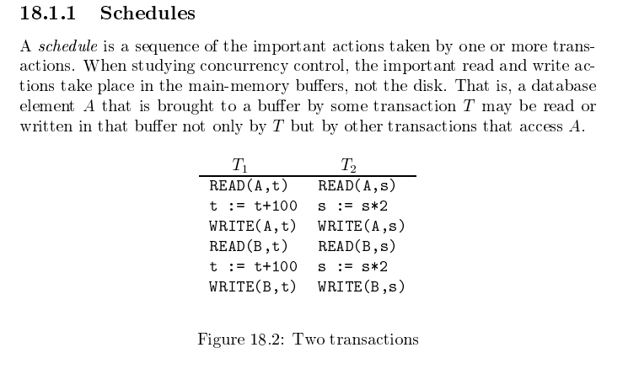
Schedule
Disks implement durability.
All programs read/write data by accessing
The relevant bytes
Of a block
In a buffer, memory frame.
Garcia-Molina et al.

Slide 9
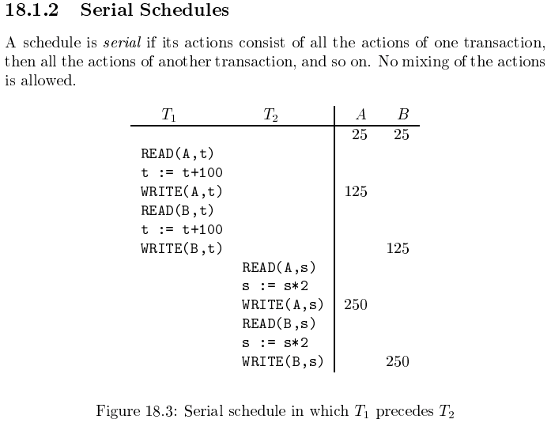
Serializable
For concurrently executing transactions.
Assume there are three
concurrently executing transactions
T1, T2 and T3
The transaction manager
Enables concurrent execution
But schedules individual operations in transactions.
To ensure that the final DB state
Is equivalent to one of the following schedules
T1, T2, T3
T1, T3, T2
T2, T1, T3
T2, T3, T1
T3, T1, T2
T3, T2, T1
Concurrent execution was serializable.

Slide 10
Scheduling Transactions
Serial schedule: Schedule that does not interleave the actions of different transactions.
Equivalent schedules: For any database state, the effect (on the set of objects in the database) of executing the first schedule is identical to the effect of executing the second schedule.
Serializable schedule: A schedule that is equivalent to some serial execution of the transactions.
(Note: If each transaction preserves consistency, every serializable schedule preserves consistency. )

Slide 11
Anomalies with Interleaved Execution
Reading Uncommitted Data (WR Conflicts, “dirty reads”):
Unrepeatable Reads (RW Conflicts):
T1: R(A), W(A), R(B), W(B), Abort
T2: R(A), W(A), C
T1: R(A), R(A), W(A), C
T2: R(A), W(A), C

Slide 12
Anomalies (Continued)
Overwriting Uncommitted Data (WW Conflicts):
T1: W(A), W(B), C
T2: W(A), W(B), C

Slide 13
Serializability (en.wikipedia.org/wiki/Serializability)
Serializability is used to keep the data in the data item in a consistent state. Serializability is a property of a transaction schedule (history). It relates to the isolation property of a database transaction.
Serializability of a schedule means equivalence (in the outcome, the database state, data values) to a serial schedule (i.e., sequential with no transaction overlap in time) with the same transactions. It is the major criterion for the correctness of concurrent transactions' schedule, and thus supported in all general purpose database systems.
The rationale behind serializability is the following:
If each transaction is correct by itself, i.e., meets certain integrity conditions,
then a schedule that comprises any serial execution of these transactions is correct (its transactions still meet their conditions):
"Serial" means that transactions do not overlap in time and cannot interfere with each other, i.e, complete isolation between each other exists.
Any order of the transactions is legitimate, (…)
As a result, a schedule that comprises any execution (not necessarily serial) that is equivalent (in its outcome) to any serial execution of these transactions, is correct.

Slide 14
Locking
14 | Introduction to Databases (F18): Lecture 12 -- Transactions, NoSQL

Slide 15
Locking and Concurrency
Application code requires a “processor/CPU” to execute.
The operating system (or execution server) allocates the CPU to a program/subprogram that is ”ready to run,” e.g.
Not waiting for an I/O to complete.
Not waiting for user input.
etc.
The operating system suspends a program and reassigns a CPU when the application performs a blocking operation, e.g.
Make a remote function call.
A disk I/O is necessary.
The program must wait for a physical or logical resource, e.g. “a lock.”
Acquiring a database lock is (potentially) a blocking operation that suspends the application until the lock request is satisfied.

Slide 16
Multitasking
In computing, multitasking is the concurrent execution of multiple tasks (also known as processes) over a certain period of time. New tasks can interrupt already started ones before they finish, instead of waiting for them to end. As a result, a computer executes segments of multiple tasks in an interleaved manner, while the tasks share common processing resources such as central processing units (CPUs) and main memory. Multitasking automatically interrupts the running program, saving its state (partial results, memory contents and computer register contents) and loading the saved state of another program and transferring control to it. This "context switch" may be initiated at fixed time intervals (pre-emptive multitasking), or the running program may be coded to signal to the supervisory software when it can be interrupted (cooperative multitasking).
Operating system allocates the CPU to one “ready to run” process at a time. The OS performs a context switch periodically, or when the process performs a non-CPU operation, e.g. I/O, wait for a message.

Slide 17
Multi-threading
In computer architecture, multithreading is the ability of a central processing unit (CPU) (or a single core in a multi-core processor) to execute multiple processes or threadsconcurrently, supported by the operating system. This approach differs from multiprocessing. In a multithreaded application, the processes and threads share the resources of a single or multiple cores, which include the computing units, the CPU caches, and the translation lookaside buffer (TLB).
Where multiprocessing systems include multiple complete processing units in one or more cores, multithreading aims to increase utilization of a single core by using thread-level parallelism,

Slide 18
Locking
Transaction Manager
Intercepts all database operations.
Acquires/checks locks on
Records
Pages
Index pages
Suspends and queues an operation
In another active, executing op.
Has a conflicting lock.
Restarts queued operations when conflicting locks are released.
Garcia-Molina et al., p. 846

Slide 19
Applications and Database Servers
Database
Management
System
(Instance)
“Client” App 2
“Client” App …
A lot of these actions happen implicitly or via defaults, e.g. autocommit.
You have to take explicit steps to bypass and used some of the functions.
Applications connect to a database (server) engine. An application may have one or more connections.
A connection may have one or more simultaneous sessions.
A session may have one or more active cursors.
Applications execute SQL statements on a cursor.
An application may begin, commit and abort transactions on a session.
An application may set an isolation level for a connection or session.

Slide 20
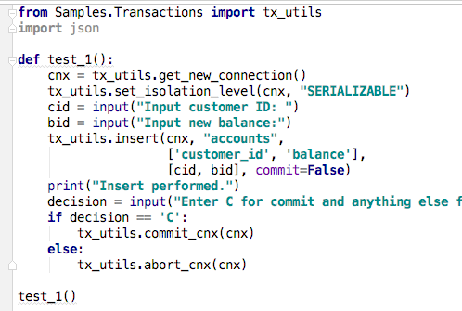

Some Demos
Two different client programs connecting to the database.
MySQL Workbench
PyCharm
Both have
Turned ”autocommit” off.
Set an isolation.
Explicitly commit/abort.
Show some cases:
SQL Workbench blocks PyCharm due to serializability and vice versa.
Repeatable read:
SQL Workbench sees the same result set despite PyCharm insert.
Sees new result after commit and starting a new transaction.

Slide 21
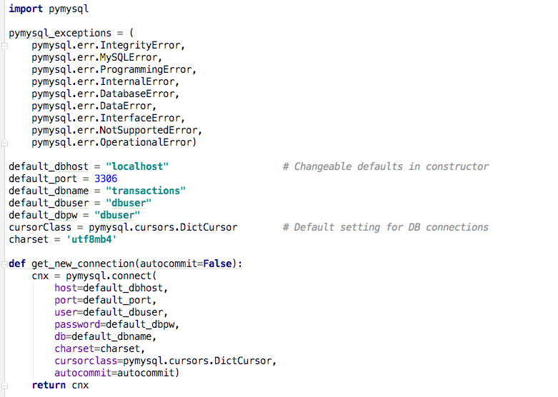
TX_UTILS Code

Slide 22
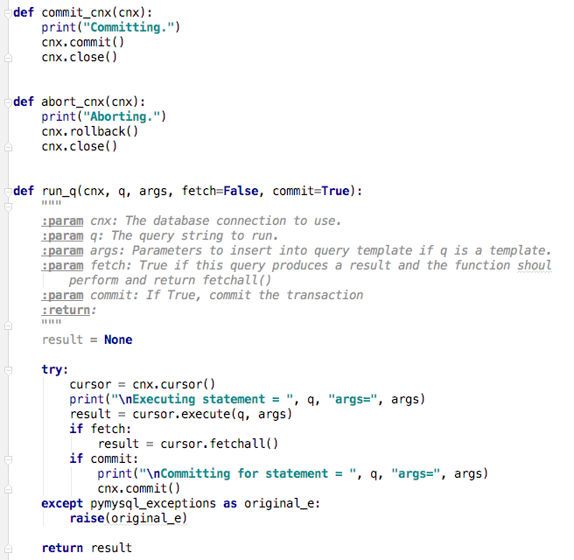
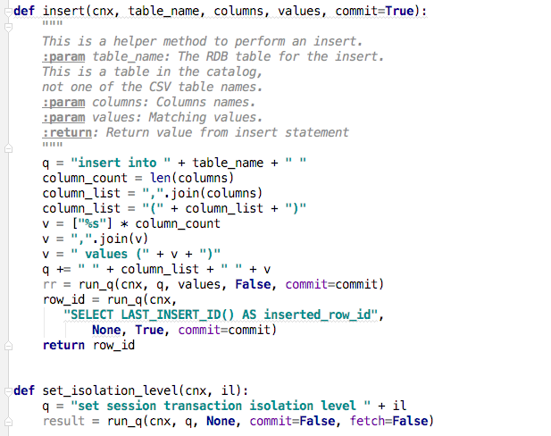
TX_UTILS Code

Slide 23
Lock-Based Concurrency Control
Strict Two-phase Locking (Strict 2PL) Protocol:
Each Xact must obtain a S (shared) lock on object before reading, and an X (exclusive) lock on object before writing.
All locks held by a transaction are released when the transaction completes
(Non-strict) 2PL Variant: Release locks anytime, but cannot acquire locks after releasing any lock.
If an Xact holds an X lock on an object, no other Xact can get a lock (S or X) on that object.
Strict 2PL allows only serializable schedules.
Additionally, it simplifies transaction aborts
(Non-strict) 2PL also allows only serializable schedules, but involves more complex abort processing

Slide 24
Aborting a Transaction
If a transaction Ti is aborted, all its actions have to be undone. Not only that, if Tj reads an object last written by Ti, Tj must be aborted as well!
Most systems avoid such cascading aborts by releasing a transaction’s locks only at commit time.
If Ti writes an object, Tj can read this only after Ti commits.
In order to undo the actions of an aborted transaction, the DBMS maintains a log in which every write is recorded. This mechanism is also used to recover from system crashes: all active Xacts at the time of the crash are aborted when the system comes back up.

Slide 25
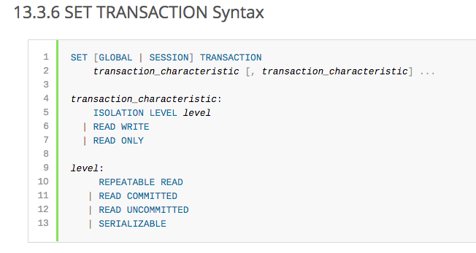
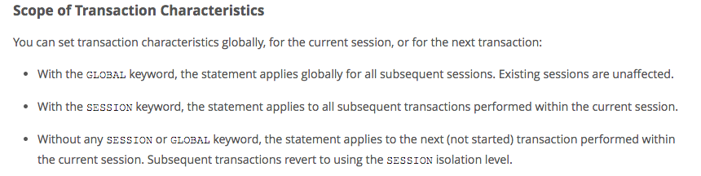
MySQL (Locking) Isolation

Slide 26
Isolation Levels (https://en.wikipedia.org/wiki/Isolation_(database_systems)
Not all transaction use cases require 2PL and serializable execution. Databases support a a set of levels.
Serializable
With a lock-based concurrency control DBMS implementation, serializability requires read and write locks (acquired on selected data) to be released at the end of the transaction. Also range-locks must be acquired when a SELECT query uses a ranged WHERE clause, especially to avoid the phantom reads phenomenon.
The execution of concurrent SQL-transactions at isolation level SERIALIZABLE is guaranteed to be serializable. A serializable execution is defined to be an execution of the operations of concurrently executing SQL-transactions that produces the same effect as some serial execution of those same SQL-transactions. A serial execution is one in which each SQL-transaction executes to completion before the next SQL-transaction begins.
Repeatable reads
In this isolation level, a lock-based concurrency control DBMS implementation keeps read and write locks (acquired on selected data) until the end of the transaction. However, range-locks are not managed, so phantom reads can occur.
Write skew is possible at this isolation level, a phenomenon where two writes are allowed to the same column(s) in a table by two different writers (who have previously read the columns they are updating), resulting in the column having data that is a mix of the two transactions.^{[3][4]}
Read committed
In this isolation level, a lock-based concurrency control DBMS implementation keeps write locks (acquired on selected data) until the end of the transaction, but read locks are released as soon as the SELECT operation is performed (so the non-repeatable reads phenomenon can occur in this isolation level). As in the previous level, range-locks are not managed.
Putting it in simpler words, read committed is an isolation level that guarantees that any data read is committed at the moment it is read. It simply restricts the reader from seeing any intermediate, uncommitted, 'dirty' read. It makes no promise whatsoever that if the transaction re-issues the read, it will find the same data; data is free to change after it is read.
Read uncommitted
This is the lowest isolation level. In this level, dirty reads are allowed, so one transaction may see not-yet-committed changes made by other transactions

Slide 27
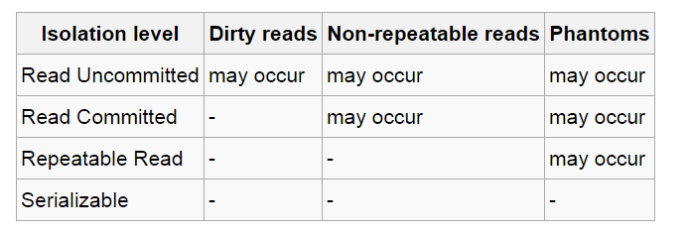
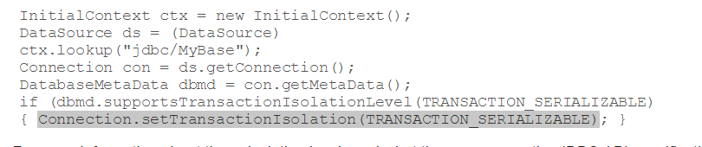
In Databases, Cursors Define Isolation
We have talked about ACID transactions
Atomic: A set of writes all occur or none occur.
Durable: The data “does not disappear,” e.g. write to disk.
Consistent: My applications move the database between consistent states, e.g. the transfer function works correctly.
Isolation
Determines what happens when two or more threads are manipulating the data at the same time.
And is defined relative to where cursors are and what they have touched.
Because the cursor movement determines what you are reading or have read.
But, … Cursors are client conversation state and cannot be used in REST.

Slide 28
Deadlock

Slide 29
Waitfor Graph
The waitfor graph has a directed edge from T1 to T2 if
T1 requests a lock on a resource.
T2 currently holds an incompatible lock on the resource.
Delete the edge when T2 releases the conflicting lock.
There is a deadlock if the waitfor graph has a directed cycle.
Breaking deadlocks:
Use the waifor graph and explicitly abort a transaction.
The more common approach is to use ”timeouts,” retry the transaction and hope the problem goes away,

Slide 30
Optimistic and Pessimistic Concurrency Control
Locking is pessimistic.
It achieves isolation and serializability.
But sometimes prevents concurrency when a conflict does not actually happen.
“Optimistic concurrency control (OCC) is a concurrency control method applied to transactional systems such as relational database management systems and software transactional memory. OCC assumes that multiple transactions can frequently complete without interfering with each other. While running, transactions use data resources without acquiring locks on those resources. Before committing, each transaction verifies that no other transaction has modified the data it has read. If the check reveals conflicting modifications, the committing transaction rolls back and can be restarted.
OCC is generally used in environments with low data contention. When conflicts are rare, transactions can complete without the expense of managing locks and without having transactions wait for other transactions' locks to clear, leading to higher throughput than other concurrency control methods.” (https://en.wikipedia.org/wiki/Optimistic_concurrency_control)

Slide 31
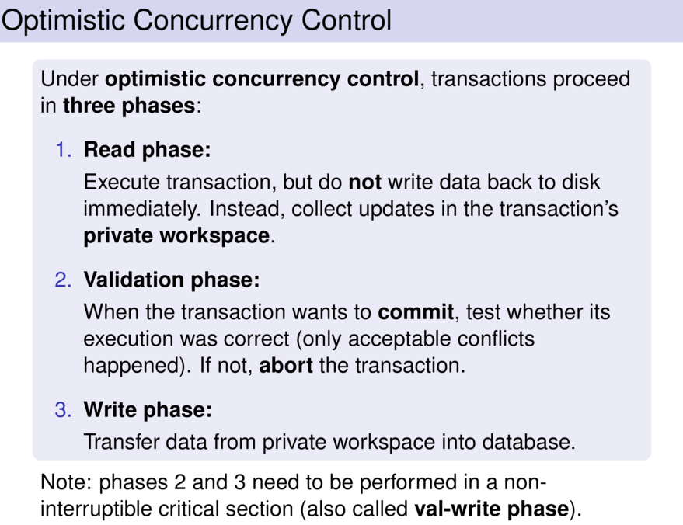
http://joerg.endrullis.de/databases/06_transactions.pdf/0224_slide.html

Slide 32
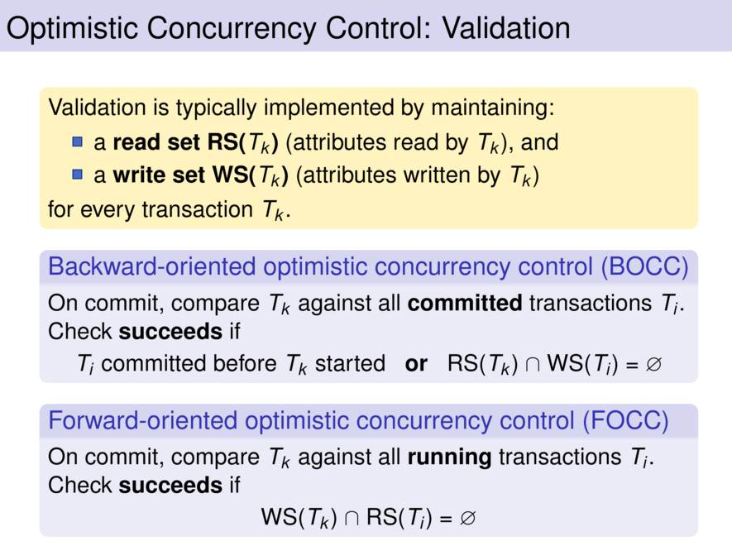

Slide 33
Transactions and REST (Remember HW 2)
33 | Introduction to Databases (F18): Lecture 12 -- Transactions, NoSQL

Slide 34
REST
"Representational State Transfer (REST) is an architectural style that defines a set of constraints to be used for creating web services. Web Services that conform to the REST architectural style, or RESTful web services, provide interoperability between computer systems on the Internet. REST-compliant web services allow the requesting systems to access and manipulate textual representations of web resources by using a uniform and predefined set of stateless operations. Other kinds of web services, such as SOAP web services, expose their own arbitrary sets of operations." (Emphasis added).(https://en.wikipedia.org/wiki/Representational_state_transfer)
The six core characteristics of the REST style are:Client–server architecture
Statelessness
Cacheability
Layered system
Code on demand (optional)
Uniform interface

Slide 35
State
REST Statelessness is easy to misunderstand.
The server clearly has long-lived state information, e.g.
Account balances.
Customer contact information.
Product catalog information in a database.
etc.
Client-Server interactions have two types of state:
Resource state
Conversation/Session
"In computer science, in particular networking, a session is a temporary and interactive information interchange between two or more communicating devices, or between a computer and user." (https://en.wikipedia.org/wiki/Session_(computer_science))

Slide 36
State
REST Statelessness is easy to misunderstand.
The server clearly has long-lived state information, e.g.
Account balances.
Customer contact information.
Product catalog information in a database.
etc.
Client-Server interactions have two types of state:
Resource state
Conversation/Session
"In computer science, in particular networking, a session is a temporary and interactive information interchange between two or more communicating devices, or between a computer and user." (https://en.wikipedia.org/wiki/Session_(computer_science))
Connections, sessions and cursors are “conversation statefull” and conflict with REST, which makes transactions difficult.
REST applications use a form of optimistic concurrency control, explicit conflict detection and application level recovery.
We saw a similar problem with LIMIT and OFFSET in HW 2

Slide 37
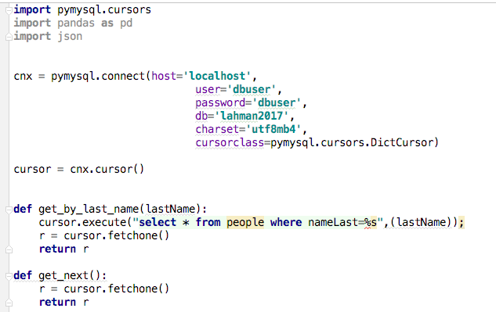
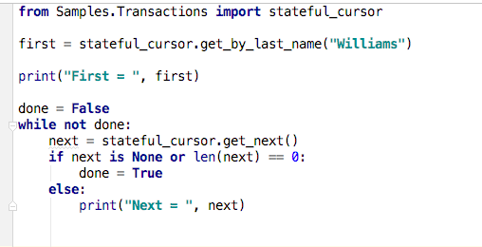
Client – Server State and Cursors Concept
(Logical) Server
(Logical) Client
Stateful session.

Slide 38
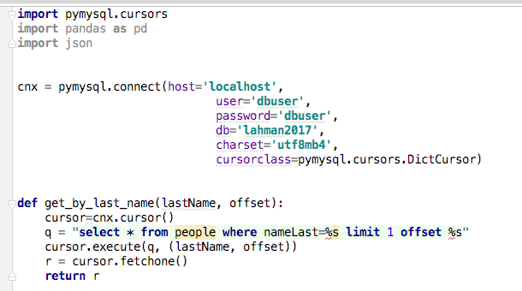
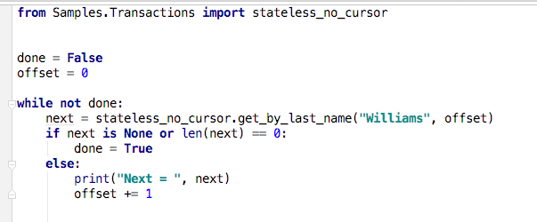
Client – Server State and Cursors Concept
(Logical) Server
(Logical) Client
Stateless interaction

Slide 39
Read then Update Conflict
Some
Resource
1. Bob GETs the resource.
3. Bob changes the data based on values.
2. Mary GETs the resource.
If
The written value
Depends on the read value.
The resource may be in the wrong state at the end.
The execution was RRWW
But the intent was RWRW.
4. Mary changes the data based on values.

Slide 40
Isolation/Concurrency Control
There are two basic approaches to implementing isolation
Locking/Pessimistic, e.g. cursor isolation
Optimistic: Before committing, each transaction verifies that no other transaction has modified the data it has read.
How does this work in REST?
The server maintains an ETag (Entity Tag) for each resource.
Every time a resource’s state changes, the server computes a new ETag.
The server includes the ETag in the header when returning data to the client.
The server may optionally maintain and return “Last Modified” time for resources.
Semantics on updates
If-Match – value of a previous calls ETag response used with a PUT or DELETE. Server should only act if nobody else has modified the resource since you last fetched it. Otherwise provides a 412.
If-Modified-Since – value of a previous Last-Modified response used with a GET. Server should only provide a response if the resource was modified since the timestamp submitted. Use in conjunction with If-None-Match in case the change occurred within the same second. Otherwise provide a 304.
If-None-Match – value of a previous calls ETag response used with a GET. Server should only provide a response if the ETag doesn’t match, i.e. the resource has been altered. Otherwise provide a 304.
If-Unmodified-Since – value of a previous Last-Modified response used with a PUT or DELETE. Server should only act if nobody else has modified the resource since you last fetched it. Otherwise provides a 412

Slide 41
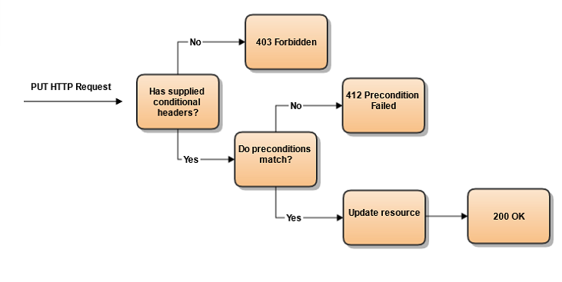
Conditional Processing (https://blog.4psa.com/rest-best-practices-managing-concurrent-updates/)

Slide 42
ETag Processing

Slide 43
NoSQL Databases
43 | Introduction to Databases (F18): Lecture 12 -- Transactions, NoSQL

Slide 44
Introduction
44 | Introduction to Databases (F18): Lecture 12 -- Transactions, NoSQL

Slide 45
Overview (I) (https://en.wikipedia.org/wiki/NoSQL)
A NoSQL (originally referring to "non SQL" or "non relational")^{[1]} database provides a mechanism for storage and retrieval of data that is modeled in means other than the tabular relations used in relational databases. Such databases have existed since the late 1960s, but did not obtain the "NoSQL" moniker until a surge of popularity in the early twenty-first century,^{[2]} triggered by the needs of Web 2.0 companies such as Facebook, Google, and Amazon.com.^{[3][4][5]} NoSQL databases are increasingly used in big data and real-time web applications.^{[6]} NoSQL systems are also sometimes called "Not only SQL" to emphasize that they may support SQL-like query languages.^{[7][8]}
Motivations for this approach include: simplicity of design, simpler "horizontal" scaling to clusters of machines (which is a problem for relational databases),^{[2]} and finer control over availability. The data structures used by NoSQL databases (e.g. key-value, wide column, graph, or document) are different from those used by default in relational databases, making some operations faster in NoSQL. The particular suitability of a given NoSQL database depends on the problem it must solve. Sometimes the data structures used by NoSQL databases are also viewed as "more flexible" than relational database tables.^{[9]}

Slide 46
Overview (I) (https://en.wikipedia.org/wiki/NoSQL)
“Many NoSQL stores compromise consistency (in the sense of the CAP theorem) in favor of availability, partition tolerance, and speed. Barriers to the greater adoption of NoSQL stores include the use of low-level query languages (instead of SQL, for instance the lack of ability to perform ad-hoc joins across tables), lack of standardized interfaces, and huge previous investments in existing relational databases.^{[10]} Most NoSQL stores lack true ACID transactions, … …
Instead, most NoSQL databases offer a concept of "eventual consistency" in which database changes are propagated to all nodes "eventually" (typically within milliseconds) so queries for data might not return updated data immediately or might result in reading data that is not accurate, a problem known as stale reads.^{[11]} Additionally, some NoSQL systems may exhibit lost writes and other forms of data loss.^{[12]} Fortunately, some NoSQL systems provide concepts such as write-ahead logging to avoid data loss.^{[13]} For distributed transaction processing across multiple databases, data consistency is an even bigger challenge that is difficult for both NoSQL and relational databases. Even current relational databases "do not allow referential integrity constraints to span databases."^{[14]}

Slide 47
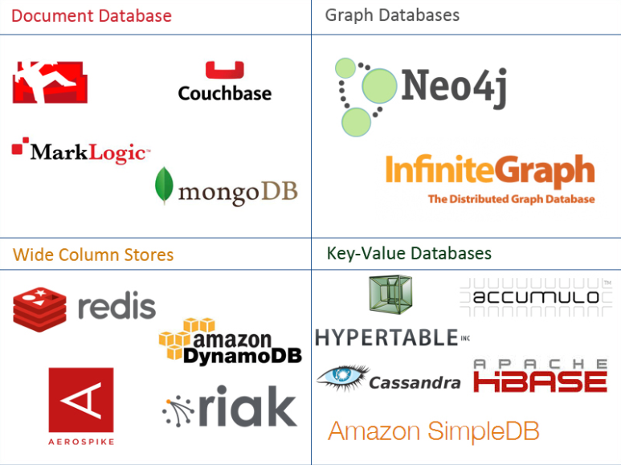
One Taxonomy

Slide 48
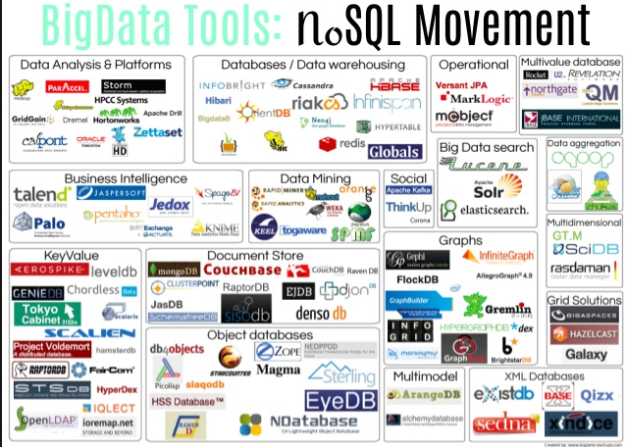
Another Taxonomy

Slide 49
CAP Theorem
49 | Introduction to Databases (F18): Lecture 12 -- Transactions, NoSQL

Slide 50
ACID

Slide 51
CAP Theorem
Consistency
Every read receives the most recent write or an error.
Availability
Every request receives a (non-error) response – without guarantee that it contains the most recent write.
Partition Tolerance
The system continues to operate despite an arbitrary number of messages being dropped (or delayed) by the network between nodes

Slide 52
Consistency Models
STRONG CONSISTENCY: Strong consistency is a consistency model where all subsequent accesses to a distributed system will always return the updated value after the update.
WEAK CONSISTENCY: It is a consistency model used in distributed computing where subsequent accesses might not always be returning the updated value. There might be inconsistent responses.
EVENTUAL CONSISTENCY: Eventual consistency is a special type of weak consistency method which informally guarantees that, if no new updates are made to a given data item, eventually all accesses to that item will return the last updated value.

Slide 53
Eventual Consistency
Availability and scalability via
Multiple, replicated data stores.
Read goes to “any” replica.
PUT/POST/DELETE
Goes to any replica
Change propagate asynchronously
GET may not see the latest value if the update has not propagated to the replica.
There are several algorithms for conflict resolution
Detect and handle in application.
Clock/change vectors/version numbers
… …
get
put

Slide 54
An Aside -- Columnar
54 | Introduction to Databases (F18): Lecture 12 -- Transactions, NoSQL

Slide 55
Columnar (Relational) Database
Columnar and Row are both
Relational
Support SQL operations
But differ in data storage
Row keeps row data together in blocks.
Columnar keys column data together in blocks.
This determines performance for different types of query, e.g.
Columnar is extremely powerful for BI scenarios
Aggregation ops, e.g. SUM, AVG
PROJECT (do not load all of the row) to get a few columns
Row is powerful for OLTP. Transaction typically create and retrieve
One row at a time
All the columns of a single row.
(https://www.dbbest.com/blog/column-oriented-database-technologies/)

Slide 56
Graph Databases
56 | Introduction to Databases (F18): Lecture 12 -- Transactions, NoSQL

Slide 57
Graph Database
Exactly what it sounds like
Two core types
Node
Edge (link)
Nodes and Edges have
Label(s) = “Kind”
Properties (free form)
Query is of the form
p1(n)-p2(e)-p3(m)
n, m are nodes; e is an edge
p1, p2, p3 are predicates on labels

Slide 58
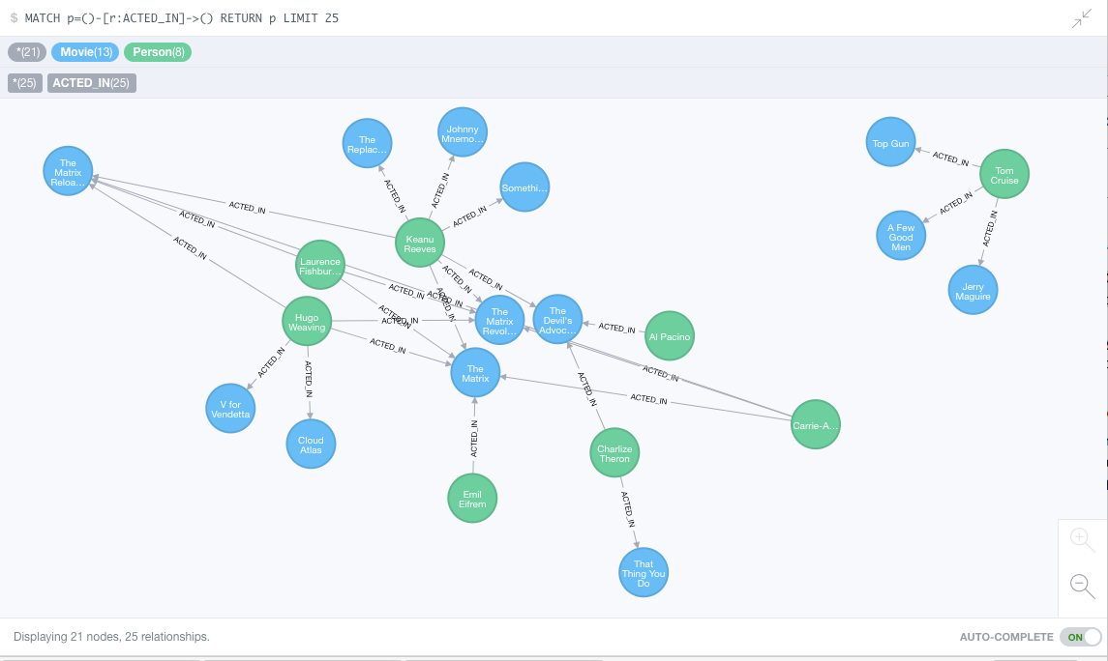
Neo4J Graph Query

Slide 59
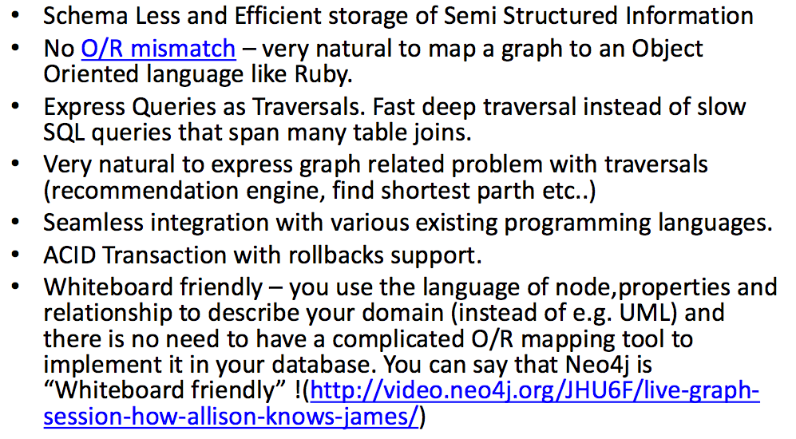
Why Graph Databases?

Slide 60
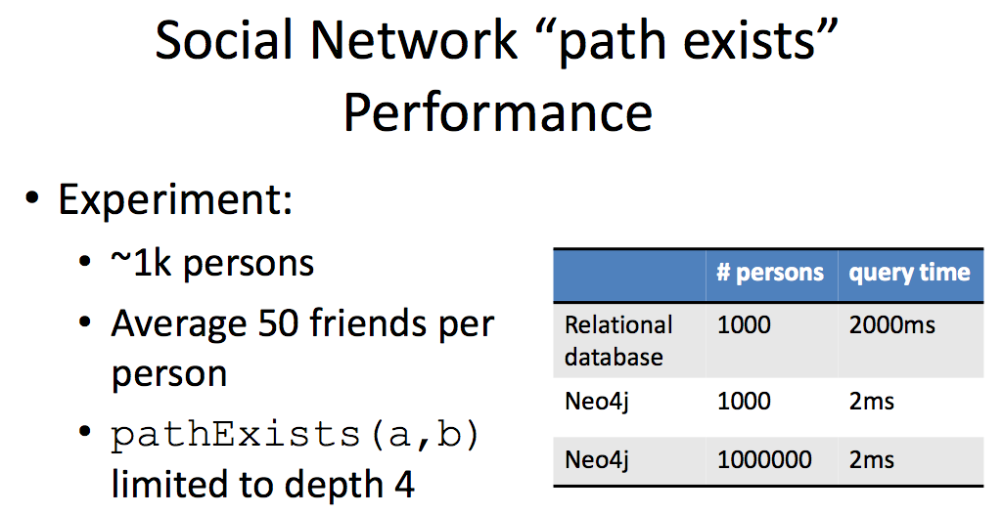
Graph databases are
Extremely fast for some queries and data models.
Implement a language that vastly simplifies writing queries.

Slide 61
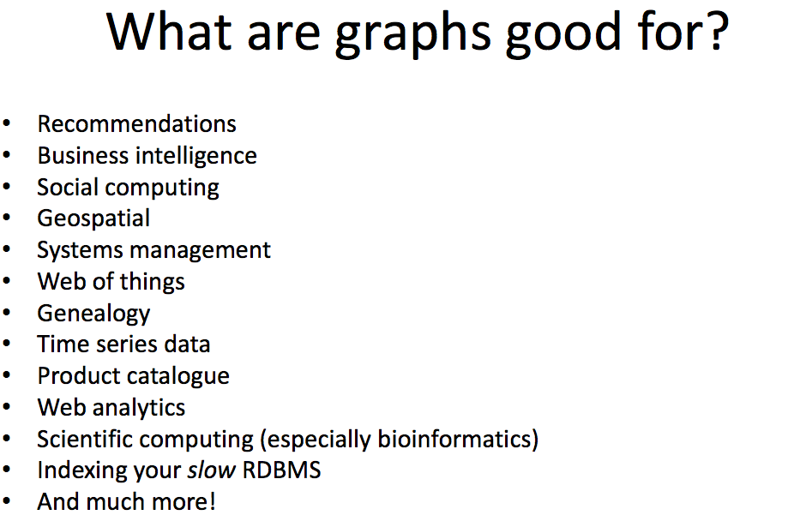

Slide 62
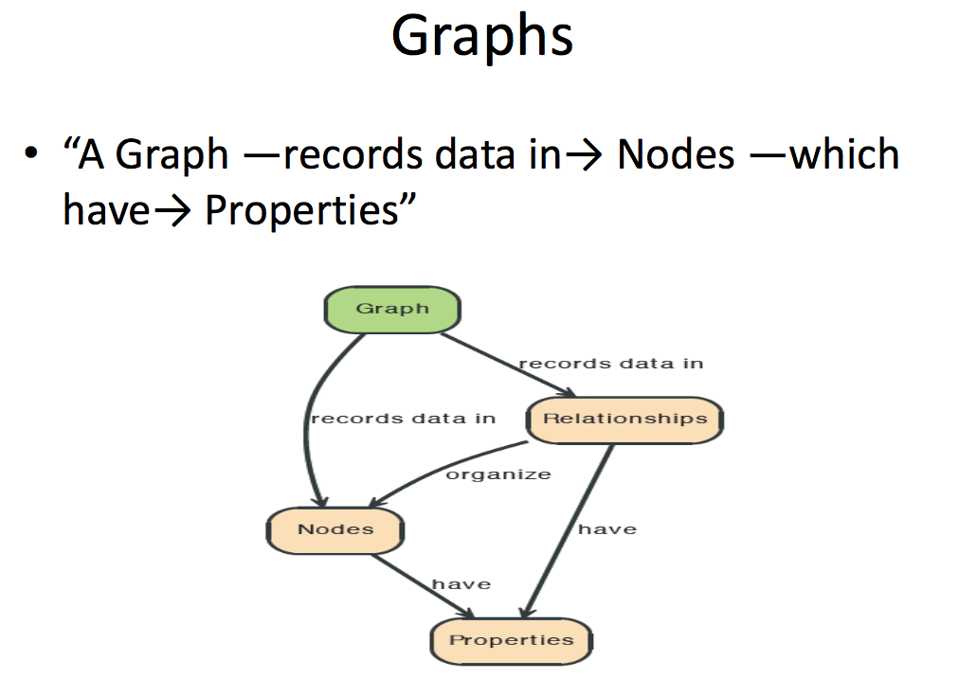

Slide 63
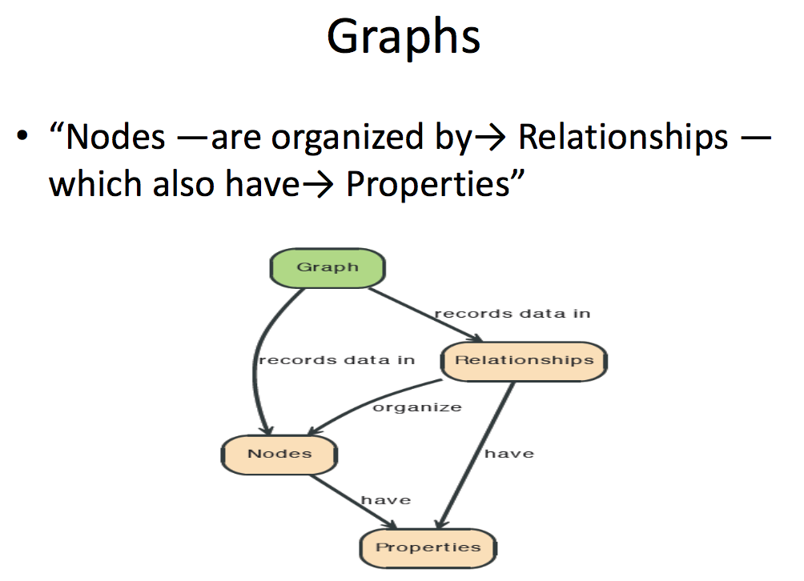

Slide 64
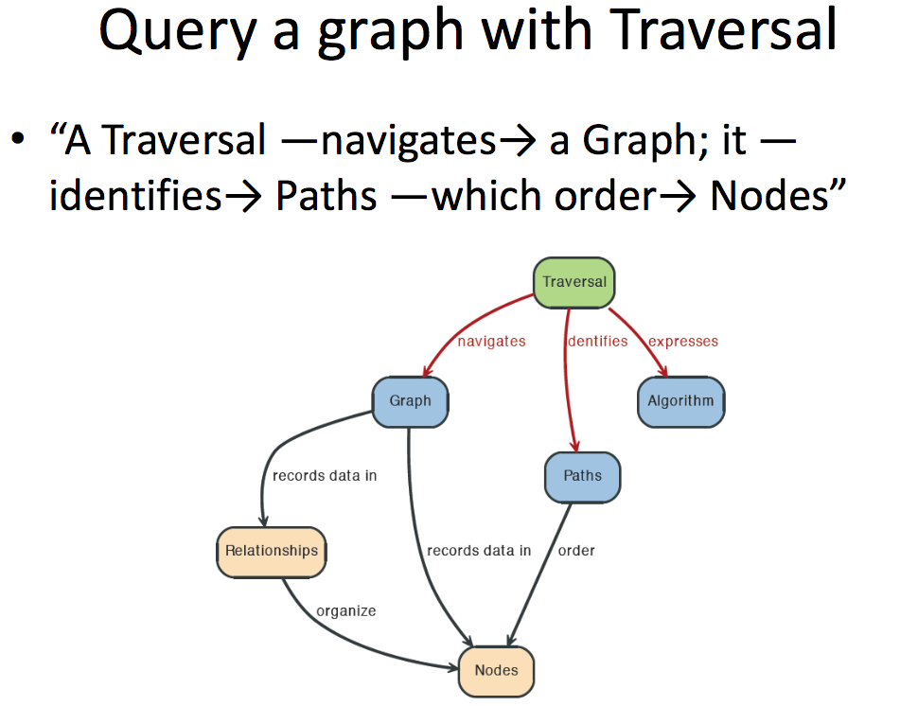

Slide 65
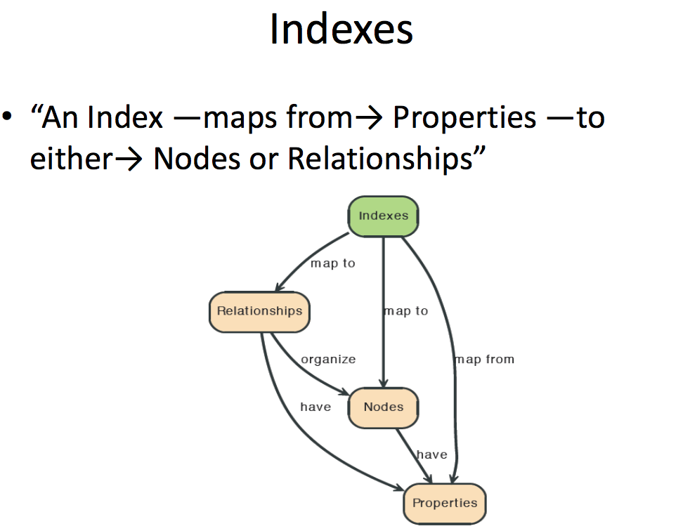

Slide 66
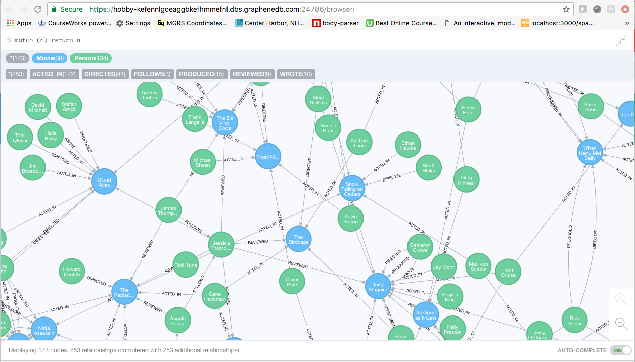
A Graph Database (Sample)

Slide 67
Neo4J Graph Query
Who acted in which movies?

Slide 68
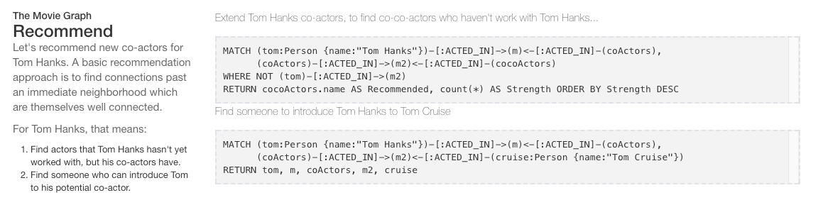
Big Deal. That is just a JOIN.
Yup. But that is simple.
Try writing the queries below in SQL.

Slide 69
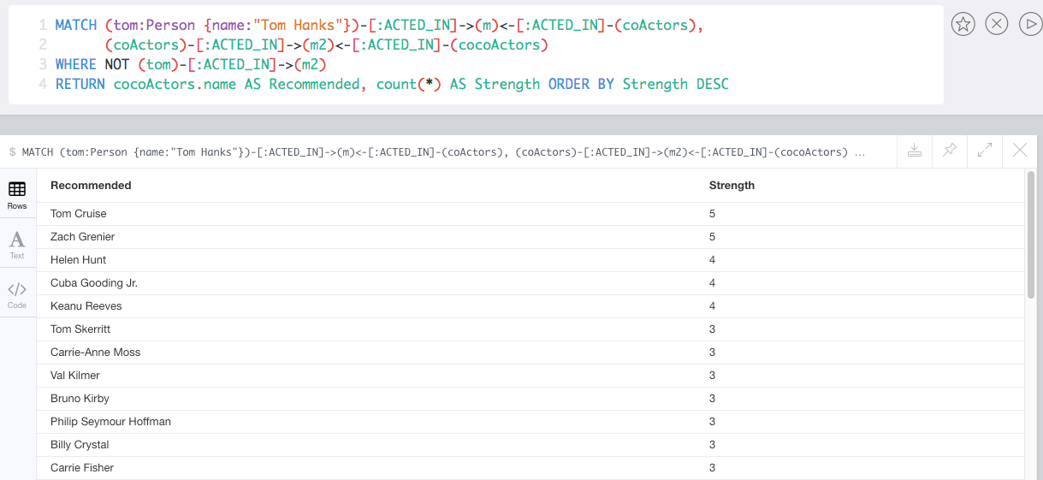
Recommend

Slide 70
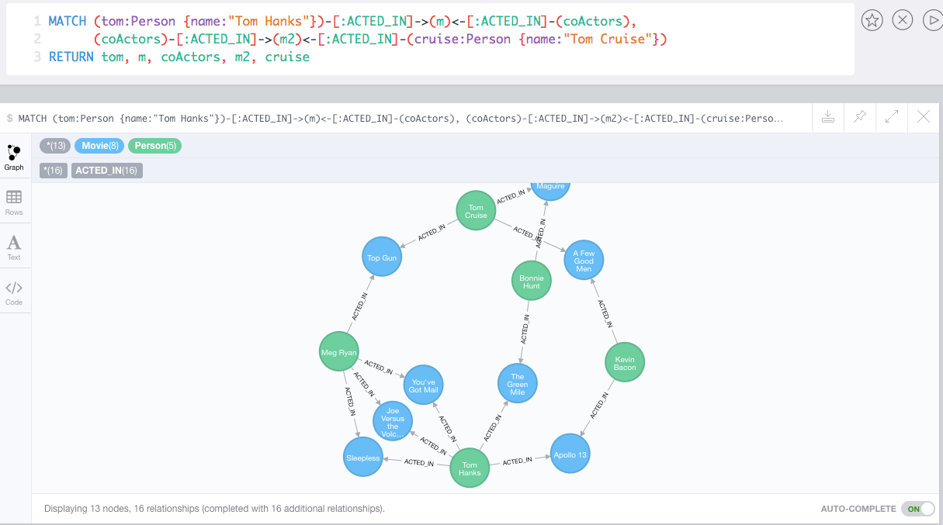
Which actors have worked with both Tom Hanks and
Tom Cruise?

Slide 71
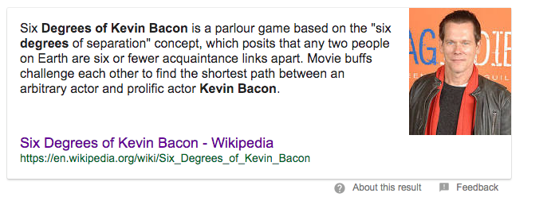
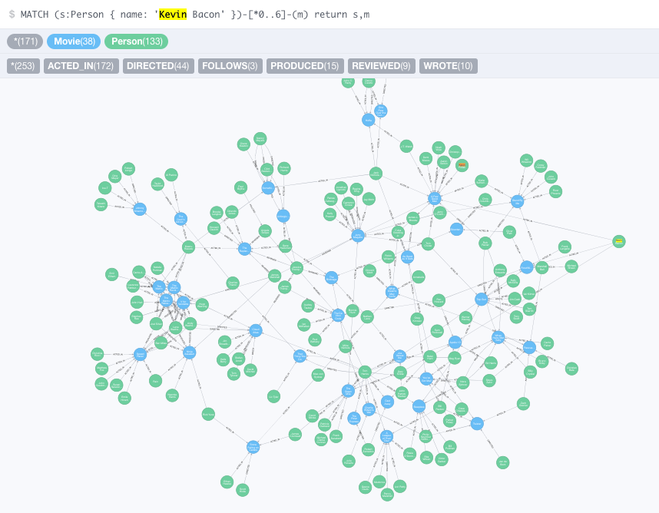


Slide 72
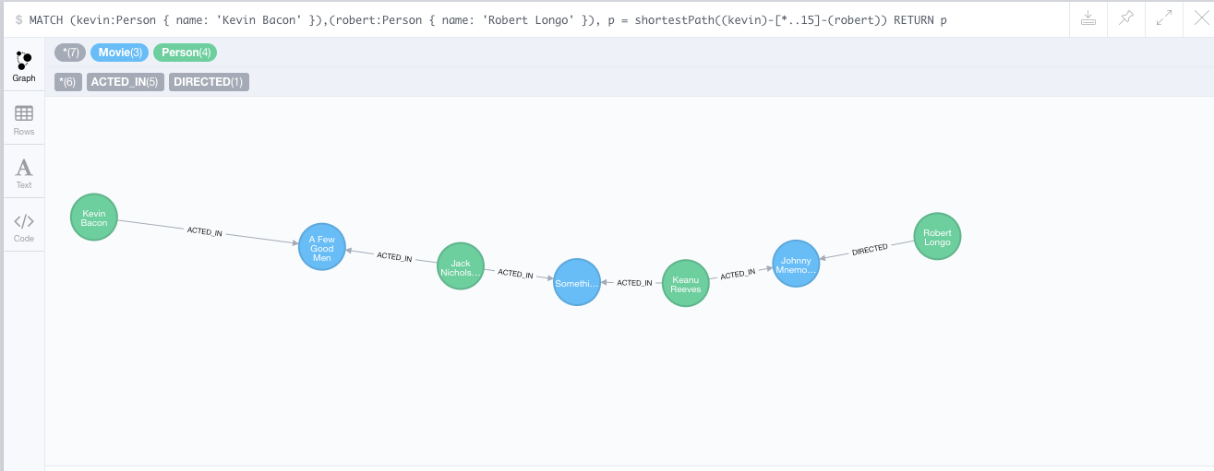
How do you get from Kevin Bacon to
Robert Longo?

